Slide 1

Highways Safety Hub
Blue Star award ideas
This presentation includes a selection of innovative ideas / suggestions for improvement

Slide 2
Blue Star awards presentation – Part 4
Temporary traffic management

Slide 3
Intro / background
Copies of all Blue Star award documents raised to-date, are available on the Highways Safety Hub web site, nested in the alerts tab page; https://www.highwayssafetyhub.com/toolkit.html
A copy of the database of Blue Star awards and H&S Toolkit ideas, hereafter referred to as the “Blue Star awards index listing”, an Excel File, is to be made available on the Highways Safety Hub web site
Content of this presentation includes an index listing of titles of Blue Star awards raised to-date, followed by a selection of ideas, in Blue Star award number
Details of H&S Toolkit ideas (19 off) will be included in a separate presentation

Slide 4
Index listing of Blue Star awards (page 1 of 5)
B000 - Plant person interface, good practice
B001 – Diphoterine
B002 - Traffic management
B003 – Health Wellbeing (Champion)
B004 – Work on bridge deck / Wind monitoring system
B005 – Safetime scaffold tags
B006 – BIM
B007 – RAG batter
B008 – Water mist fire extinguisher
B009 – Smart screens
B010 – Mission Room
B011 – Controlling permits to work
B012 – WAH / Load and unload vehicles
B013 – Gridforce 30
B014 – Dumper camera
B015 – Excavator stickers
B016 – Chapter 8 chevrons
B017 – Occupational health (3 year plan)
B018 – TM airlock
B019 – Health, safety, wellbeing strategy
B020 – Training

Slide 5
Index listing of Blue Star awards (page 2 of 5)
B021 – Readi-guard (RO) TM airlock gates
B022 – Bunkabin accommodation
B023 – Competence
B024 – Technology to improve safety (BIM)
B025 – Red Zone training
B026 – Public route planning
B027 – Safety pegs to maintain TBS zone
B028 – Control of vehicles leaving site
B029 – Vehicle payload and weights sheet
B030 – Message boot laces
B031 – Google maps S&O planning
B032 – LGV enforcement
B033 – HAVwear watches
B034 – LED lights on goal posts
B035 – Briefing document (daily)
B036 – Call button for ped access to site
B037 – QR codes and NFC readers
B038 – Skipper tape exclusion zone
B039 – Value engineering
B040 – Improving communication

Slide 6
Index listing of Blue Star awards (page 3 of 5)
B041 – Incident investigation
B042 – TM (influencing drivers / body cams)
B043 – PatrolLive
B044 – Work behind access and exit points
B045 – Control of HAVS (PAM breaker)
B046 – Safety gates
B047 – Works access gate (WAG)
B048 – Site security)
B049 – A duplication of BS Award 43
B050 – A duplication of BS Award 44
B051 – Animated RAMS
B052 – Yellow mat
B053 – SMART SITE monitors
B054 – Vest and helmet lights
B055 – TM works order management system
B056 – TM nightshift isolation plan
B057 – Service avoidance
B058 – 2-way radios, key info, dumper cam
B059 – Use of stop gates
B060 – Plant person interface training

Slide 7
Index listing of Blue Star awards (page 4 of 5)
B061 – Induction training area 1
B062 – PPI, JCB Hydradig, Prolec restrictors
B063 – LifeVac
B064 – Virtual reality (VR) training
B065 – Rotating dumper cab
B066 – Surface mining (use of Power Plane)
B067 – Occupational health, fatigue
B068 – Service avoidance
B069 – Overhead protection
B070 – Banners (bridge name / No / location)
B071 – Remote drilling (No HAVS)
B072 – MEWP virtual reality training simulator
B073 – Drone tech aerial mapping stockpiles
B074 – Halo Deployment ‘Worker Guardian’
B075 – Base Light 420x portable lighting
B076 – Virtual reality PPI training
B077 – Hi-vis dumper
B078 – Milwaukee 6232 Band saw
B079 – GTL gas to liquids fuel
B080 – VMS overhead protection

Slide 8
Index listing of Blue Star awards (page 5 of 5)
B081 – VMS TM exit
B082 – Trimble site vision
B083 – Survey giraffe
B084 – Public pedestrian safety
B085 – Emergency call button
B086 – V2 VDZ System
Blue Star awards, issued by calendar year:
2015 – 11no.
2016 – 44no. (+2no. Duplicates)
2017 – 12no.
2018 – 11no.
2019 – 2no.
2020 – 3no.
2021 –
Total = 83no.

Slide 9
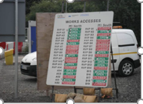
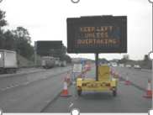
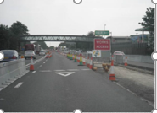
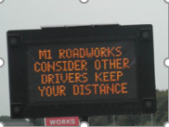
B002 – Traffic management
Traffic management:
Current access / egress points displayed on board at exit from site compound and a text sent to senior management and supervisors each day.
Yellow and green coloured road cones in place to identify access points.
Sensor operated VMS signs advising the travelling public to move over if a vehicle is trying to exit the works

Slide 10
B002 – Traffic management
Traffic management:
Influencing Driver Behaviour at Roadworks, with VMS signs used to encourage good driving through the works and to provide general safety information / warnings.

Slide 11
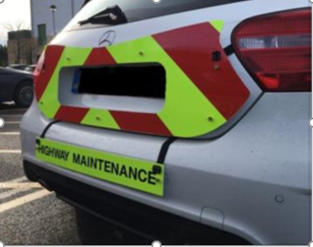
B016 – Chapter 8 chevrons
Developed temporary signage to overcome the issue of the back of vehicles having non-metallic boots and bumpers
They do not require placing of adhesive chevrons to the rear of the vehicles which can cause excessive costs for repairs from the hire and leasing companies upon return

Slide 12
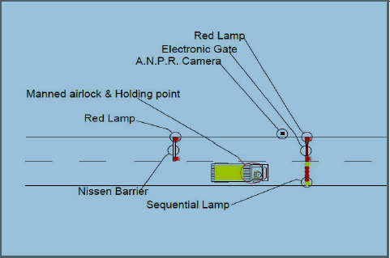

B018 – TM Airlock
Provides a sterile area which permits the passage of people, vehicles and objects between two points via a series of gates which do not open simultaneously.
It allows a gateman to control access and stop unauthorised breaches by the travelling public.
This is achieved by holding them in the area between the two closures.
Automatic Gate Used to control Access at the Western end of the airlock
Airlock Electronic Gate detail used at East End of Closure

Slide 13
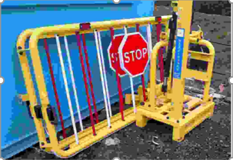
B021 – Readi-guard (RO) TM airlock gates
During resurfacing works on a scheme, it was necessary to install full closures of the M11 Motorway which required closures of the slip roads.
Interserve TM utilised Readi-Guard remotely operated automated air lock gates at the closure points.
These barriers are powered by 12V battery so no mains power required.

Slide 14
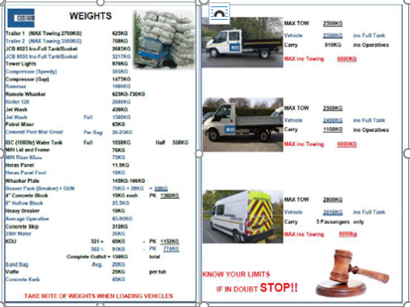
B029 – Vehicle payload and weights sheet
Information sheet that provides clear information of accurate vehicle payloads with additional information of the weights of general materials that are transported on site

Slide 15
B042 – Body Cams
Traffic management –
Body cams worn by gatemen who control access to the site when night time closures are installed, which promotes a good public interface and evidence in the case of dispute with MOP’s.
Working with the local truck stop, the site offered free quick 10 minute health checks for the HGV drivers who use the new road.
No photo available

Slide 16
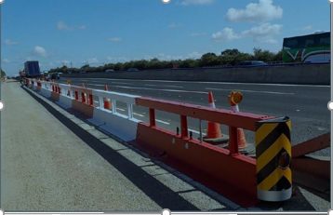
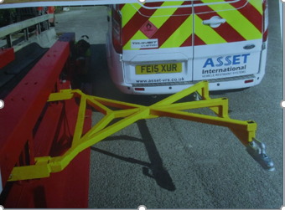
B047 – Works Access Gate (WAG)
WAG for closing site access and exits –
Based on Asset’s Solarguard temporary barrier system, it can be moved and positioned manually by “jacking” the system up on to fixed trolley types wheels, allowing the system to be moved in and out of place at any works access / exit point, without affecting the traffic flows (lane closures).
Works Access Gate (WAG) system
Towing bar for pulling WAG into position

Slide 17
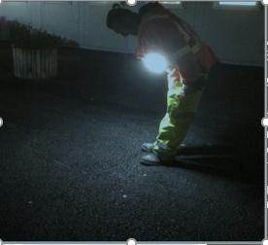
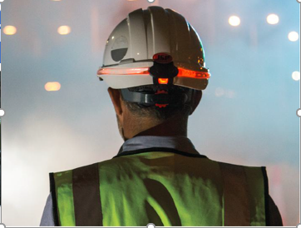
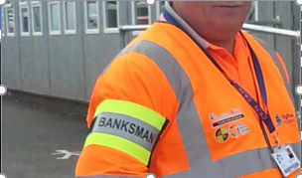
B054 – Vest and safety helmet lights
Improvements to the quality of PPE has included
A light vest to improve visibility of night workers,
LED and fibre optic helmet light to ensure black helmets are visible at night,
High visibility arm band to identify banksmen

Slide 18
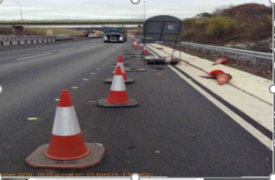
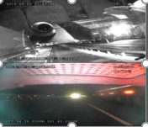
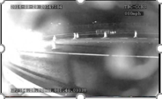
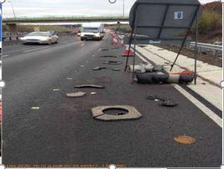
B055 – 360° cameras fitted to TM vehicles
360° cameras fitted to TM vehicles provide real time images whilst they are working on site.
These live images can be reviewed at any computer screen connected to the internet, these lives feds can be viewed via mobile devises and desk top computers.

Slide 19
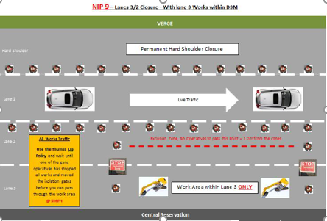
B056 – TM nightshift isolation plan
TM nightshift isolation plan:
Due to the diversity of activities undertaken within temporary TM i.e. night time lane closures, a suite of Nightshift Isolation Plans (NIPs), detailing where and how the “STOP” and “SLOW” gates are to be used, have been produced.
8 different schematics which detail how the NIP’s must be implemented are in place

Slide 20
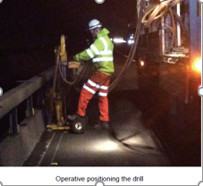
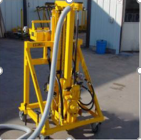
B071 – Remote drilling
Remote drilling –
The Varioguard barrier being used is the next generation design and as such the methods of fixing have been greatly improved.
The EZ Drill purchased by Asset International is a huge breakthrough in the initiative of achieving zero HAVS by 2020.
Query: What about training in safe use, handling, transportation and storage of drill rigs?

Slide 21
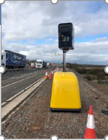
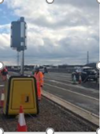
B074 – Halo Deployment
Halo Deployment ‘The Worker Guardian’ –
Has been utilised to record actual traffic incursions at access / exit points within the works.
Traditionally methods rely on near miss reporting from site or identification by CCTV operators.
At one works access point where the traditional method only captured 7 incursions, the Halo camera captured 200.

Slide 22

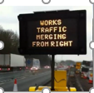
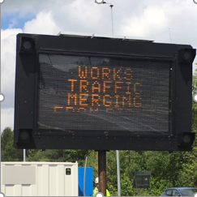
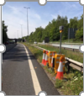
B081 – VMS TM exit
VMS TM exit –
Having identified the hazard of site vehicles R/H merging from works exits into live lane 3 and the increased risk of RTC's presented by HGVs due to the speed and density of the traffic.
It was decided to use a Portable Variable Message Signs (pVMS) within the central reserve, to warn the public that works traffic is merging from the right.

Slide 23
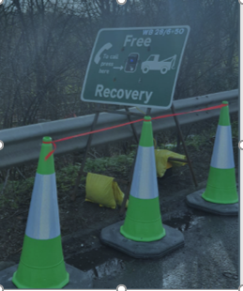
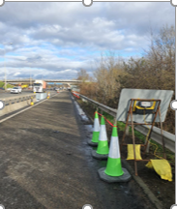
B085 – Emergency call button
HRS’ Portable Emergency Call Point is a customisable and easy to deploy interactive terminal that allows two-way communication between road users who have broken down in the road works or an emergency refuge area and a control room.
The sign face can easily be customised
All devices are monitored remotely and status, number of calls, battery can be seen in a secure web portal

Slide 24
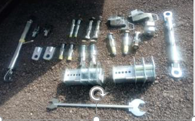
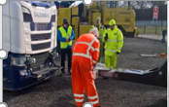
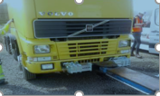
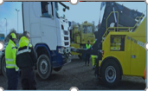
B086 – V2 VDZ System
Saunders Recovery & BBV, supported by Highways England HETO’s have successfully trialled and implemented a new recovery system called VDZ System.
With modern trucks encompassing new technology within design and development for greater payloads, the complex design and manufacture of these trucks requires a new approach for the recovery and transportation should the vehicle require towing

